Slide 1
CLIENT STATS DATA ANALYSIS

Slide 2
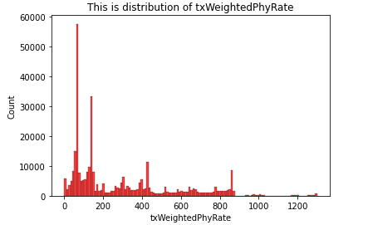
Distribution of txWeightedPhyRate
Observation: Certain outliers are found in txWeightedPhyRate which needs to be further analyzed.

Slide 3
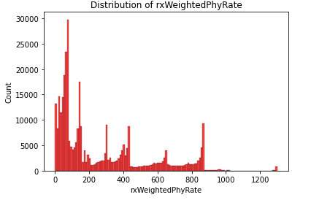
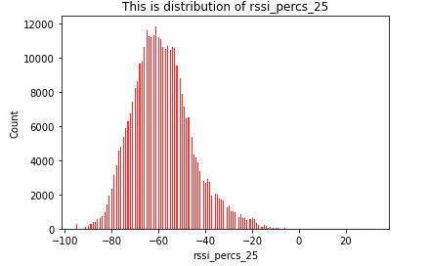
Step 1
Q1. Look at the RSSI levels (rssi_percs_25) and look at the spread of Tx and Rx weighted Phy Rate
Observation: Certain outliers are found in rxWeightedPhyRate which needs to further analyzed.
Rssi_percs_25 is bit right skewed.

Slide 4
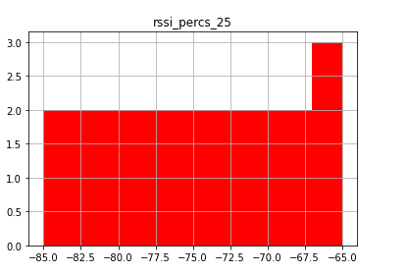
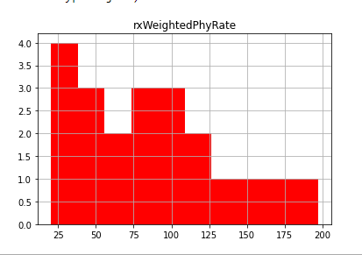
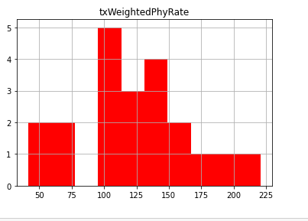
Q2. Produce a histogram and CSV file for the average of Tx ad Rx weighted Phy rate between -85 and -65 db in 1 db steps

Slide 5
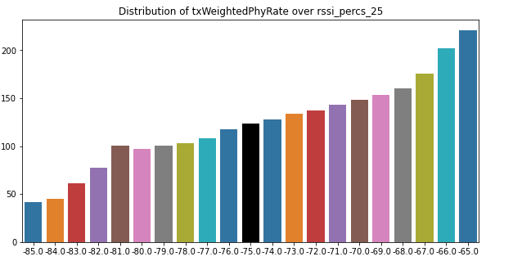
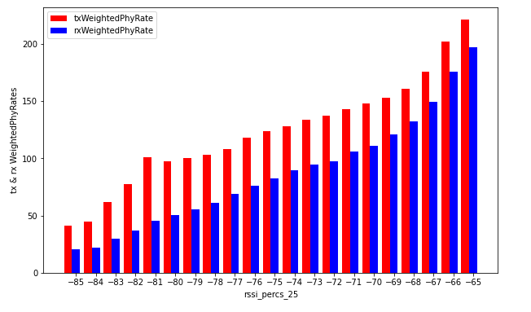
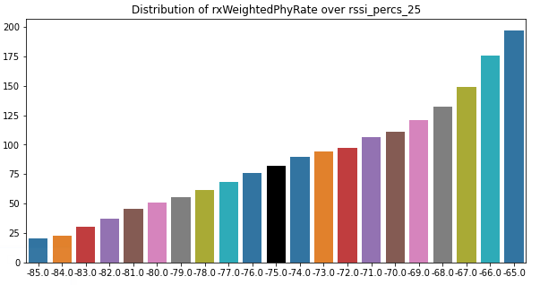
Observation: No : of bins in both rxweightedphyRate and txWeightedPhyRate is 21 between -85 and -65 in 1 db.

Slide 6




PIPELINE FLOW
STEP 02
STEP 01
STEP 03
01->Saved data from data processing of
avg Tx and Rx Weighed Phy Rate between
-85 and -65 dB in 1 dB steps is taken as csv.
02->Set the config file in logstash.
03-> Store the indexed documents in elastic search.
04-> Visualize the data in grafana.
STEP 04

Slide 7
Step 2
Q1. Percentage of devices connected with 2.4GHz and 5GHz respectively
Ans:
Total count
Percentage of the 2.4G device in complete dataset = 45.59%
Percentage of the 5G device in complete dataset = 54.41%
Unique count
Percentage of the 2.4G device in complete dataset = 1.70 %
Percentage of the 5G device in complete dataset = 1.734 %
Q.2 Percentage of devices connected with 2.4GHz and 5GHz respectively based on given condition
Ans:
Total Count
Percentage of the 5G device in New model dataset = 69.80%
Percentage of the 2.4G device in New model dataset =30.16%
Unique Count
Percentage of the 2.4G device in complete dataset = 1.37%
Percentage of the 5G device in complete dataset = 2.24%
Q3. Will we gain more devices on 5GHz.
Ans: Yes. 5G devices are expected to increase significantly in this case. The results are influenced with assumption
made during the analysis

